Slide 1
Bias, Variance, Overfitting & Underfitting

Slide 2
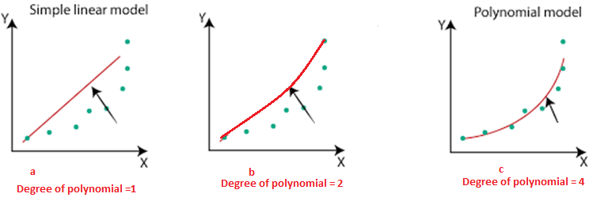
Regression
In Figure a – whenever I train a model my error rate is very high for both train and test data (underfitting) → High Bias and High Variance
In figure c – each point fits perfectly on a line for training data. But for test data the accuracy goes down (overfitting) → Low Bias(train data) and High variance (test)
In figure b – accuracy level is high for both train and test data → Low Bias and Low Variance

Slide 3
Classification
Model 1 (overfitting)
Training Error : 1%
Test Error : 20%
Low Bias
High variance
Model 2 (Underfitting)
Training Error : 25%
Test Error : 26%
High Bias
High Variance
Model 3(Generalized model)
Training Error : <10%
Test Error : <10%
Low Bias
Low Variance

Slide 4
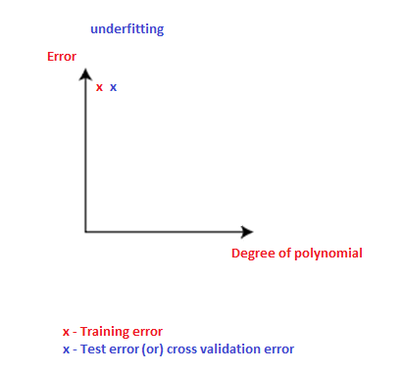
Visualization

Slide 5
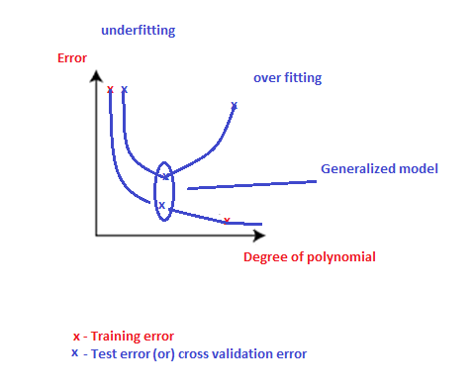
Generalized model

